Slide 1

Introduction to the Home Health Department

Slide 2
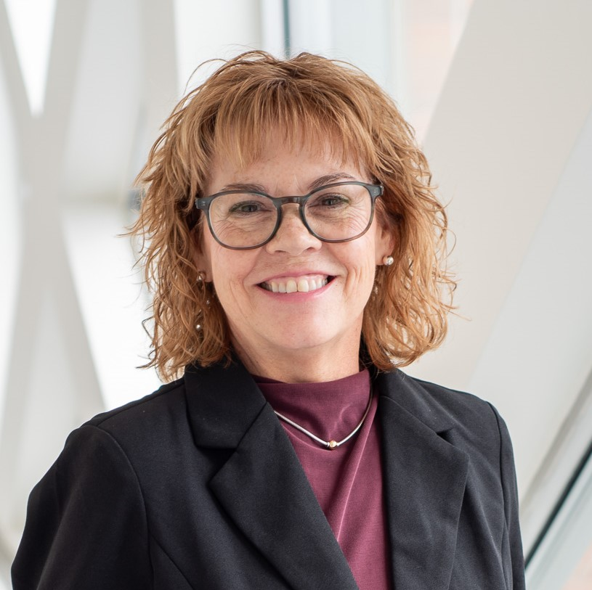
Kathy Sousa DNP, RN, MSM, HCA
Administrator of Home Health and Home Support

Slide 3

Why does wellness matter?
Wellness is about feeling your best - body, mind, and spirit – so you can keep doing the things you love.
Whether its staying active, connecting with others, or simply enjoying each day, our goal is to help you live well, stay safe, and remain independent in the comfort of your home.

Slide 4

Services for Heights Club Members
North Hill Rehabilitation and Holistic Health can provide outpatient rehabilitation and holistic therapies to help you maintain an active lifestyle
North Hill Home Health – a traditional visiting nurse agency offering nursing, physical therapy, occupational therapy, and home health aides
Home Support – additional services to help you remain healthy and support you during any arising health challenges
This Photo by Unknown Author is licensed under CC BY-SA-NC

Slide 5
North Hill Rehabilitation and Holistic Health
Services Provided
All services require a physician's order
Currently offering Physical Therapy and Speech Therapy
A golf putting green can assist in your recovery for those who are golf enthusiasts
Core STIX – this equipment mimics functional movement patterns to build strength, balance, and coordination
Specialty Services
LSVT Loud Therapy provided by Speech Therapist – focus is on Parkinson’s Disease but can benefit other neuromuscular disorders that affect speech
LSVT Big – physical therapy component for Parkinson's Disease and other neuromuscular disorders
Pelvic Floor Treatment by a physical therapist
Acupuncture Therapy
Massage Therapy

Slide 6
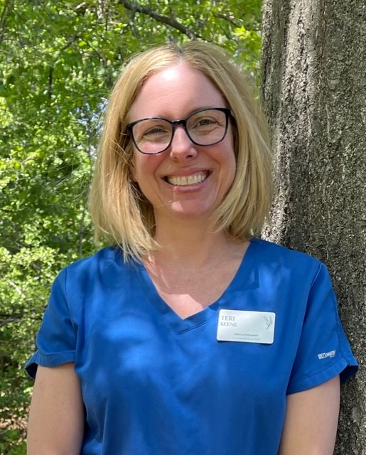
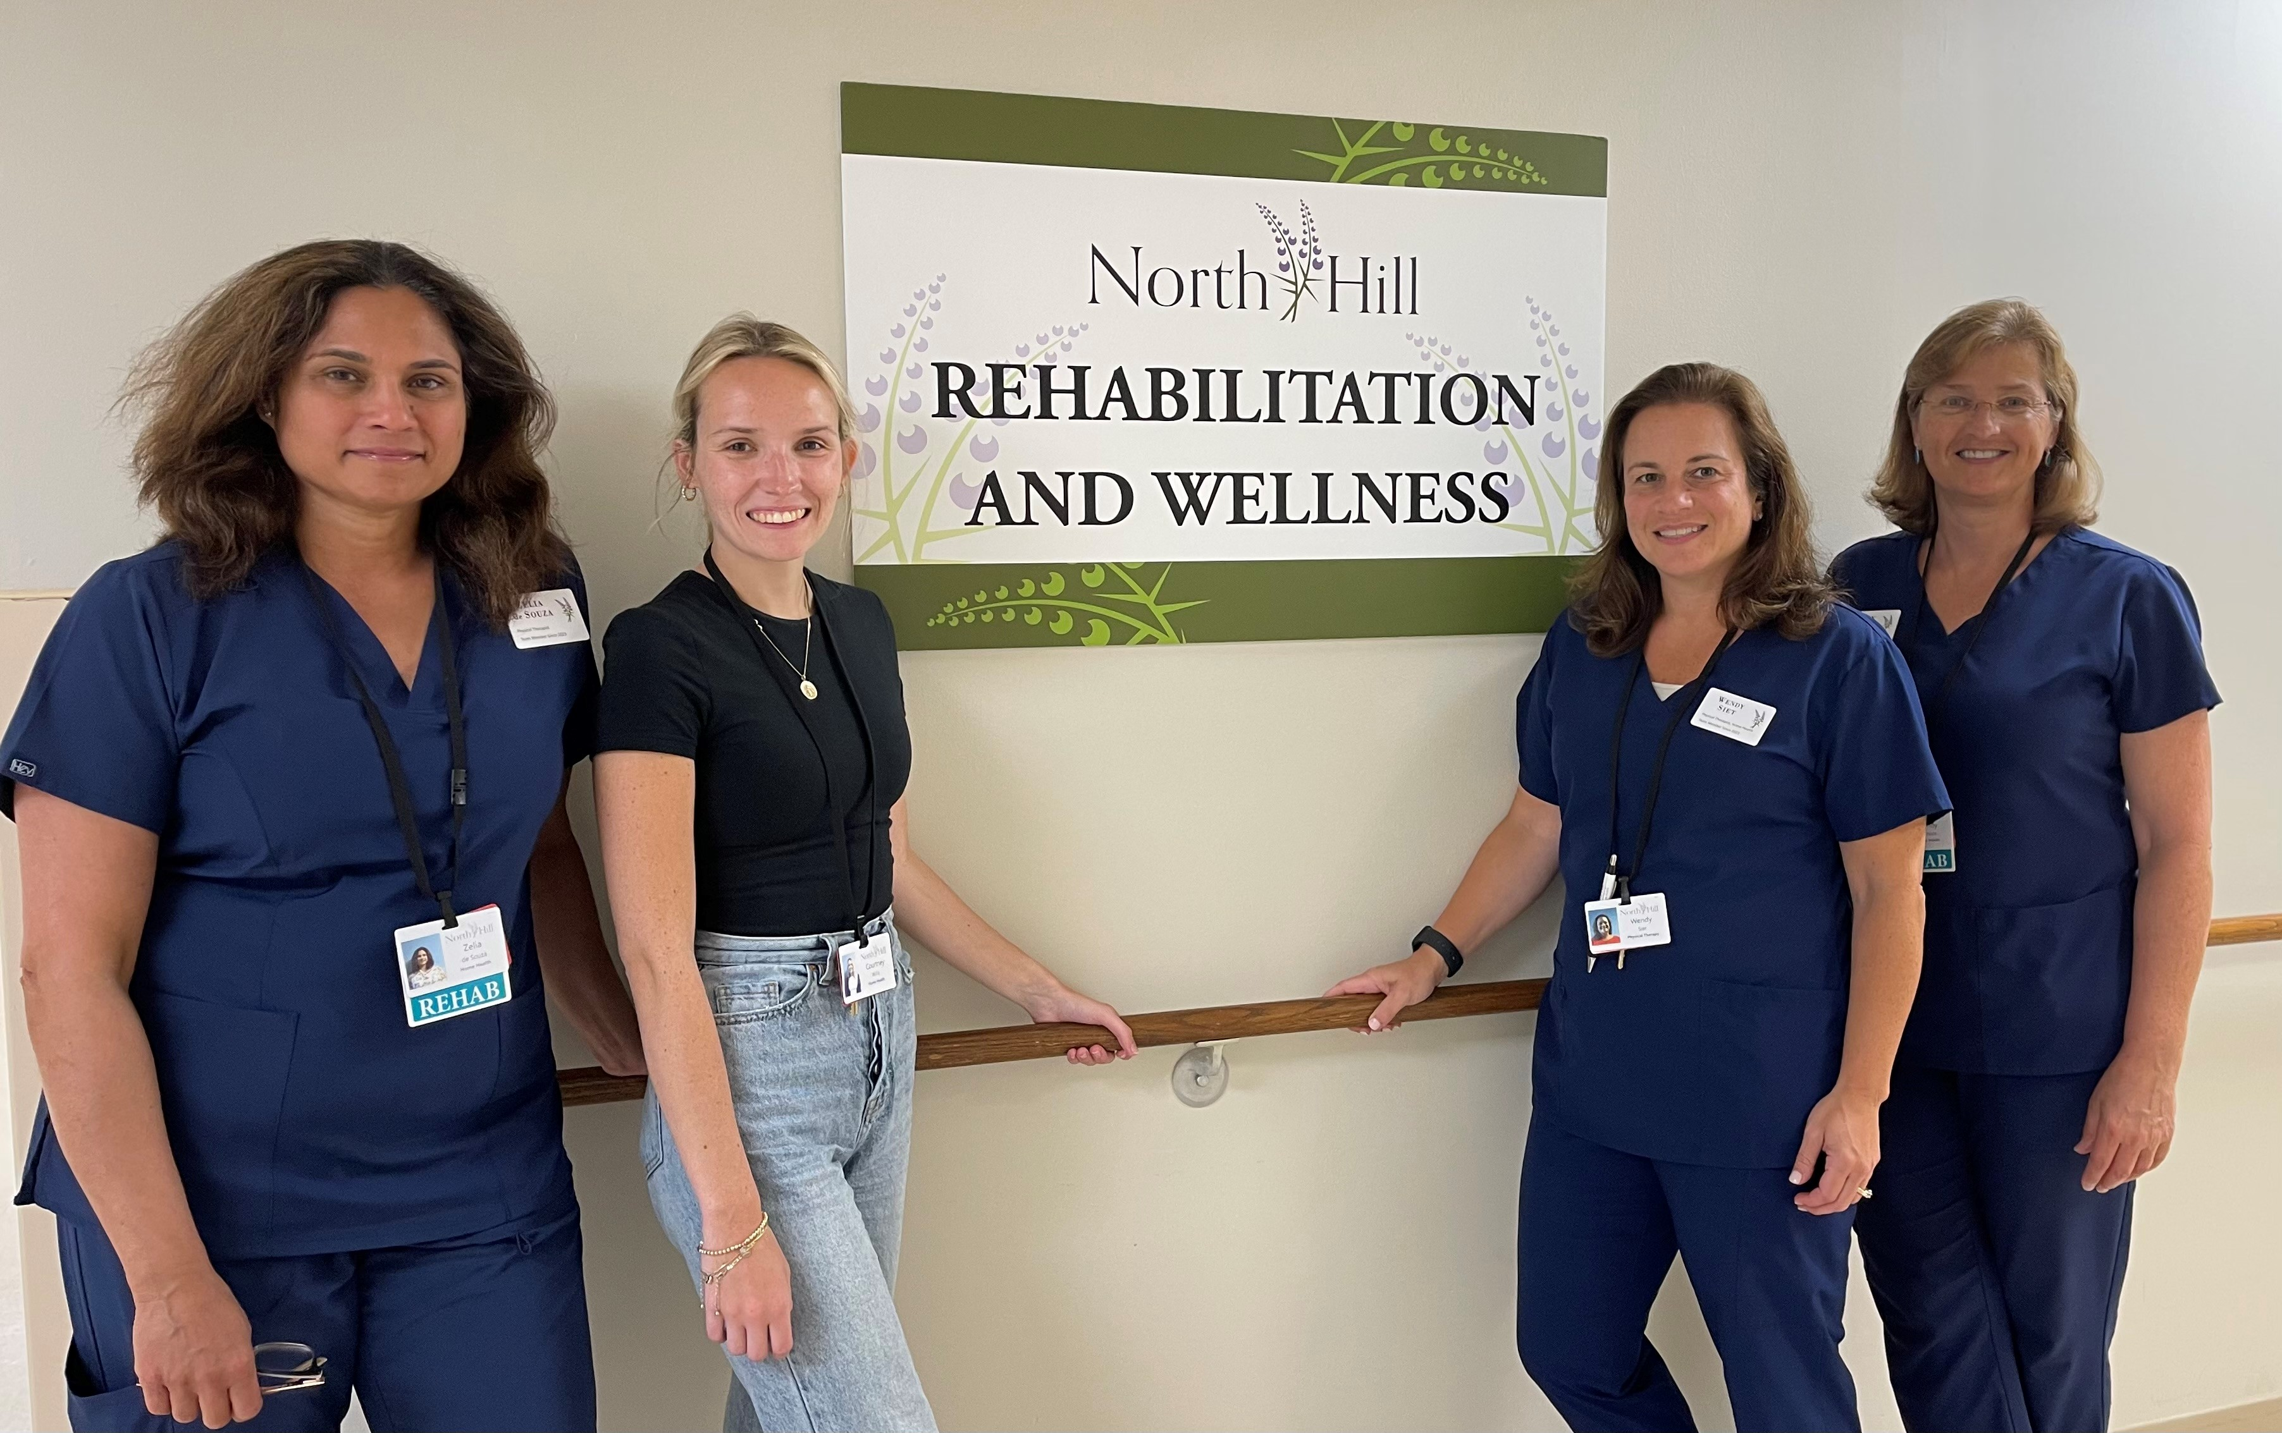

Slide 7
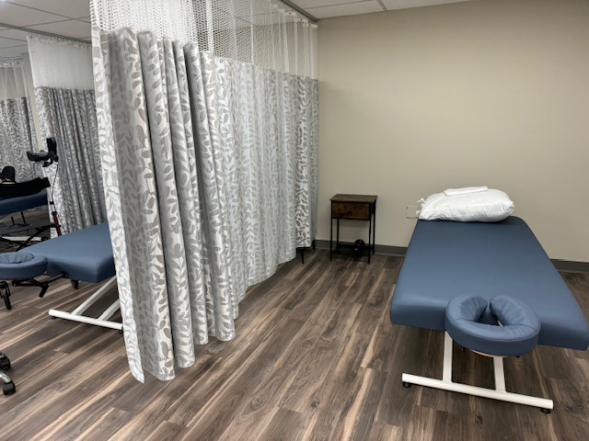
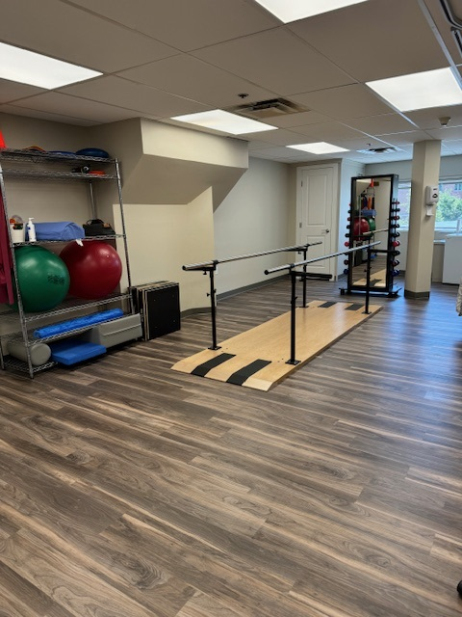
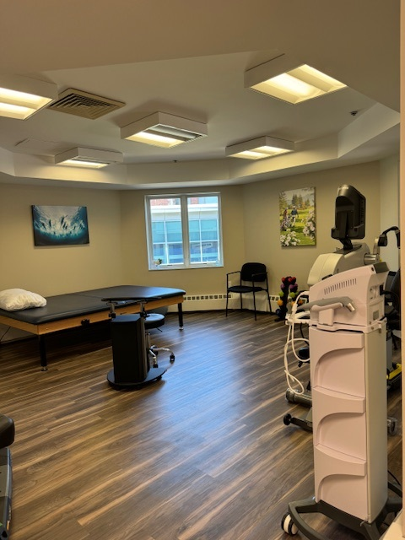
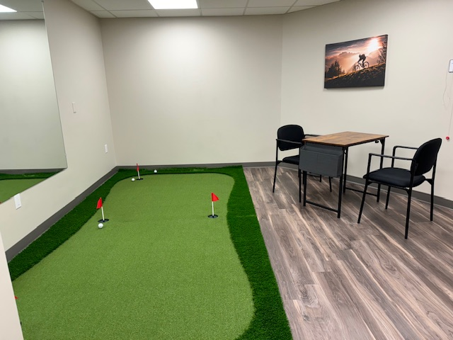

Slide 8
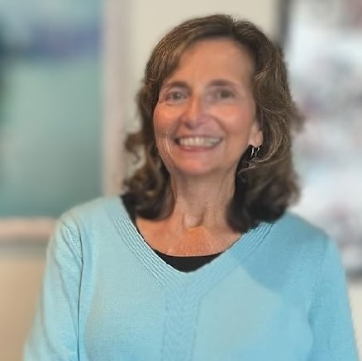
Debra Doherty
MSN, RN, COS-C
Home Health Clinical Manager

Slide 9
Why choose home health care?
Recovery
Prevention
Restorative
Supportive services
Enhance quality of life

Slide 10

Home Health Certified
Provide Nursing, Physical Therapy, Occupational Therapy, Speech Therapy, Home Health Aide, Medical Social Worker
Must have a physician order with documentation of a recent physician appointment
Must have a qualifying diagnosis for the care to be covered by Medicare or other insurance
Must be homebound according to the Medicare criteria for homebound status
If Medicare, Medicare Advantage plans, or private insurance do not cover your care, Home Support may be an option.

Slide 11
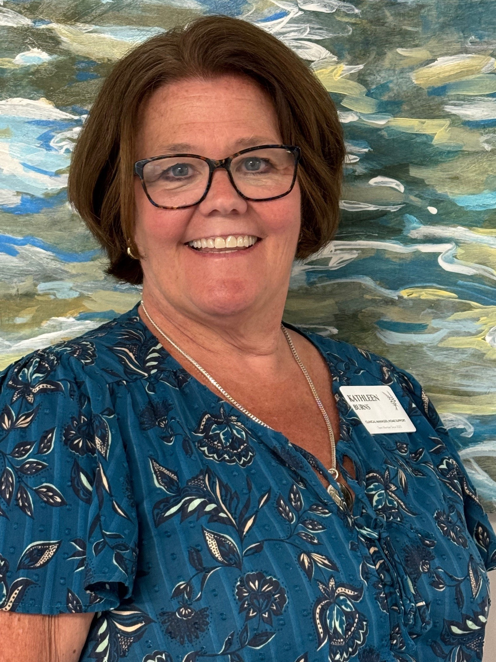
Kathy Burns RN, BSN, MSM, HCA
Home Support Clinical Manager

Slide 12
Home Support Services
Nursing – health assessment, simple wound care, medication management, and assist with medical equipment
Therapy – safety evaluation, balance and equipment evaluation; follow–up treatment plans/exercise plan after insurance exhausted
Home Health Aide – personal care, bed changing for those no longer capable of completing the task, assist with compression stockings, laundry, and light meal prep
Registered Dietitian
Home organization, Pet Care (call for details)
Accompany to medical appointments

Slide 13
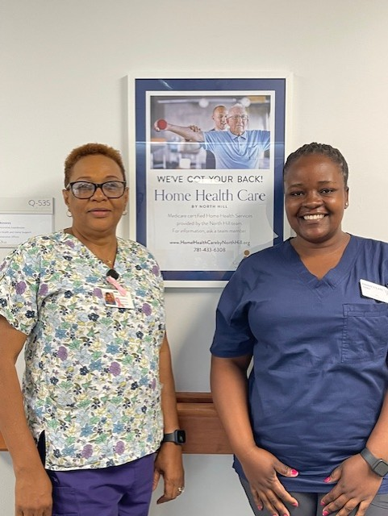
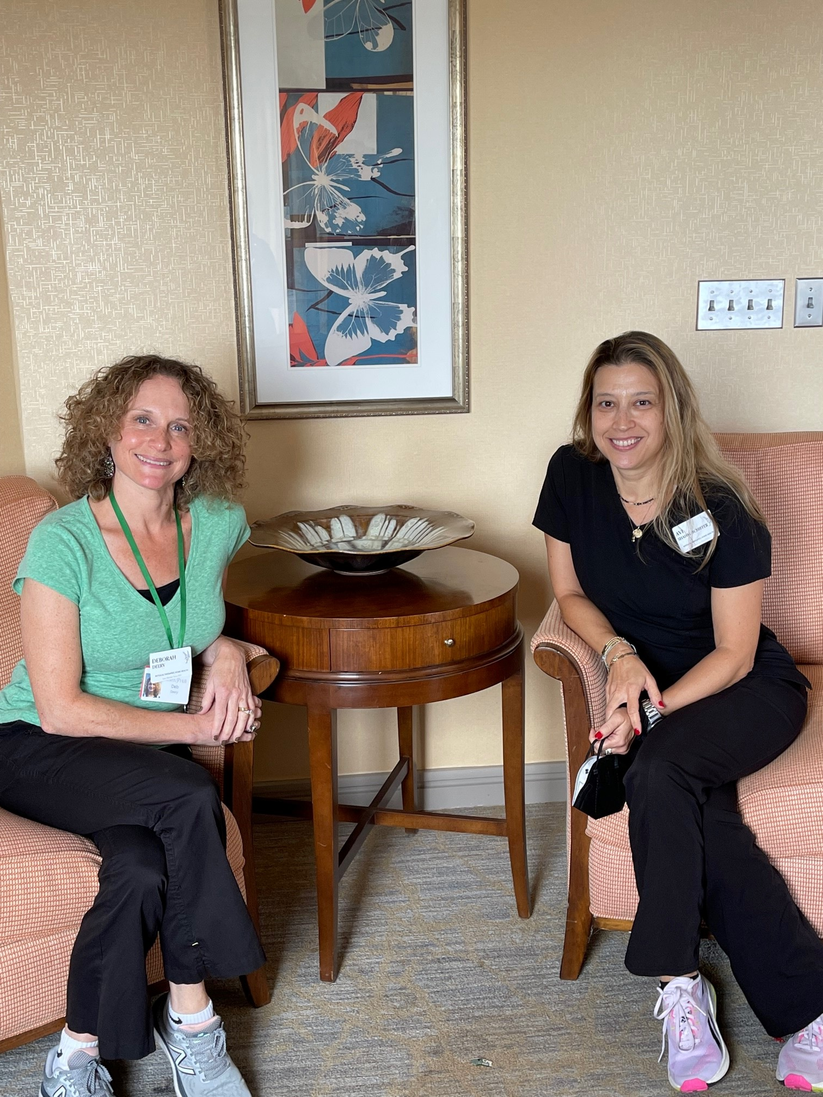

Slide 14
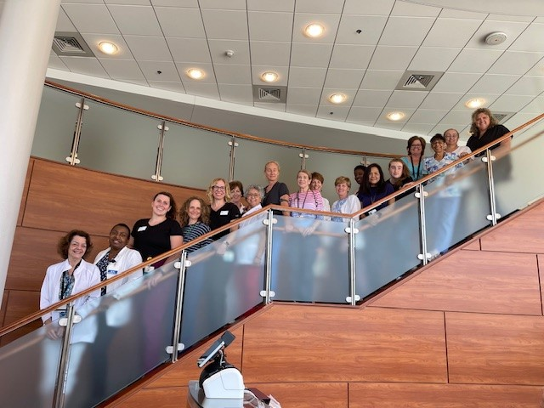

Slide 15

Home Health isn’t just about recovery – it’s about staying well, staying safe, and staying home.
This Photo by Unknown Author is licensed under CC BY

Slide 16
Pines Edge
Pines Edge offers a full range of on-site clinical services to enhance wellness, provide support and achieve optimal level of independence and recovery.
Care is provided by skilled interdisciplinary clinicians including Nursing, MD/NP, dietitian, care partners, purposeful living, social services, PT,OT and speech therapy, specialty medical providers.
Short term rehabilitation: Providing 24/7 interdisciplinary skilled care to residents recovering from surgical or medical illness. Examples of care provided: post operative care, physical/occupational/speech therapy, intravenous therapy, medication management, nutrition services, pain management, orthopedic rehabilitation, cardiac/pulmonary rehabilitation, and wound care.
Respite service: Respite care allows primary care givers time to rest. Residents are cared for by the interdisciplinary team and provided care that is personalized and supportive. Respite service is often used while primary care takers are away and 24/7 oversight or hands on support is needed. A 5-day stay is required.

Slide 17
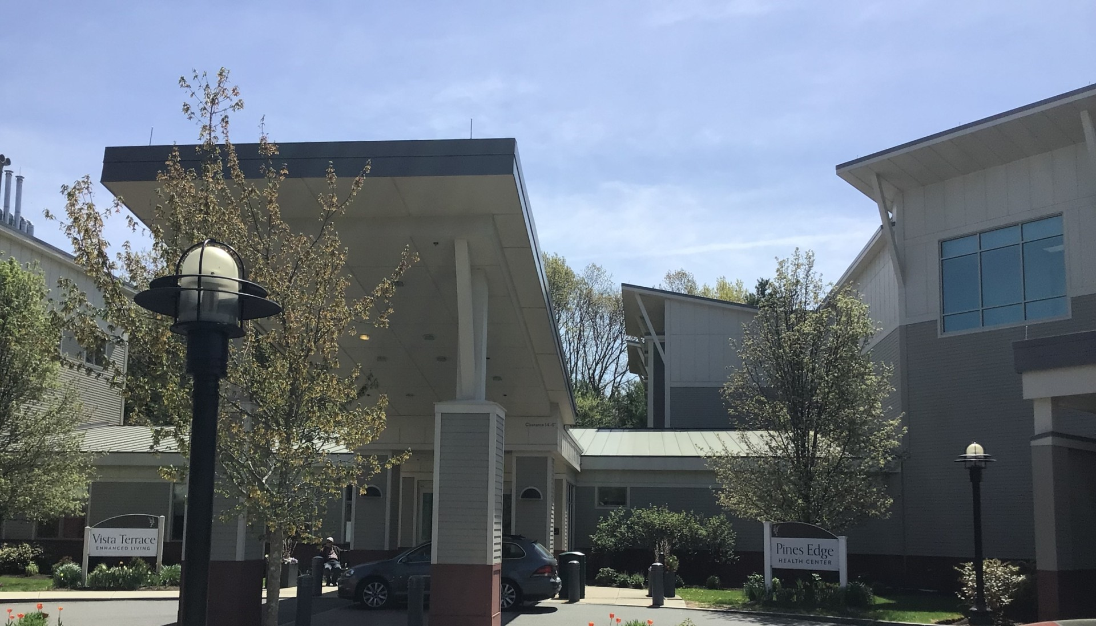

Slide 18
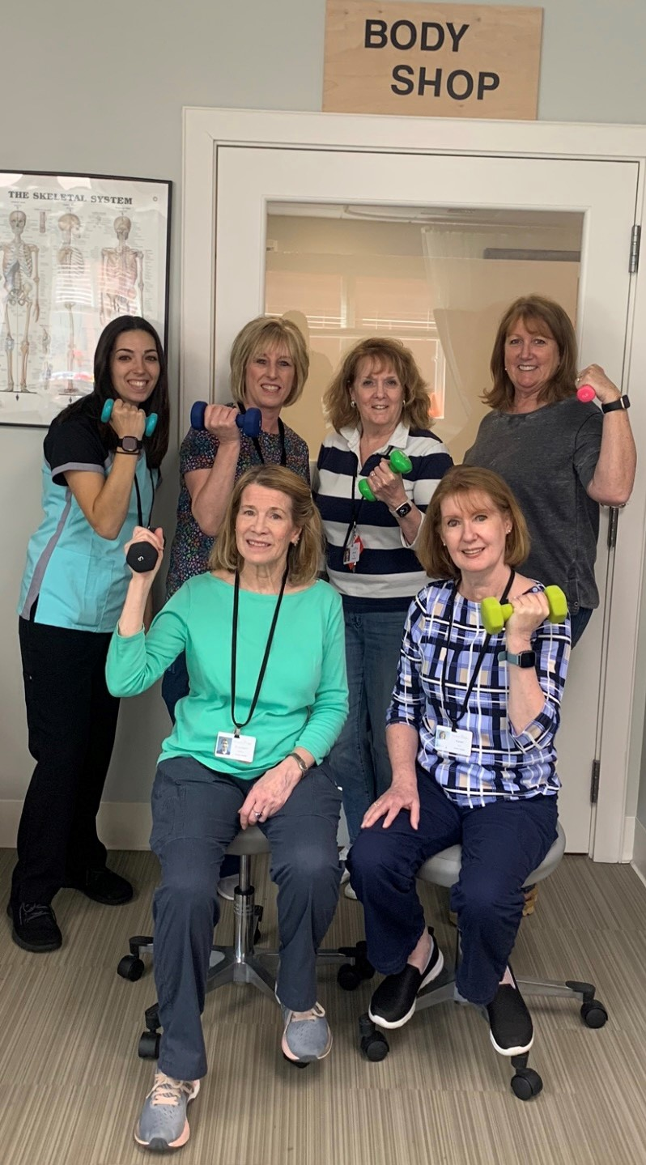
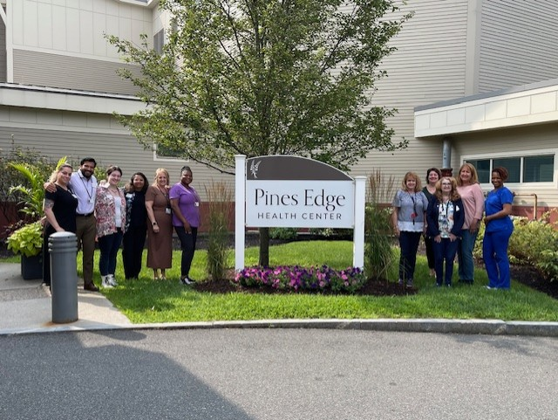

Slide 19
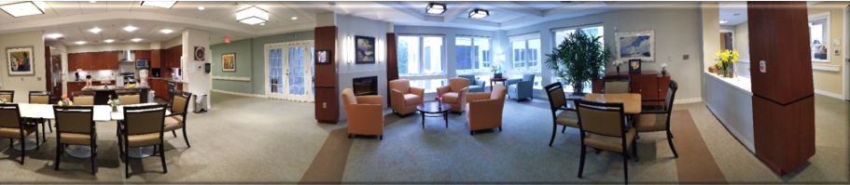

Slide 20
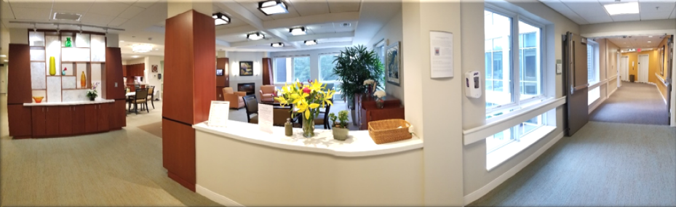

Slide 21
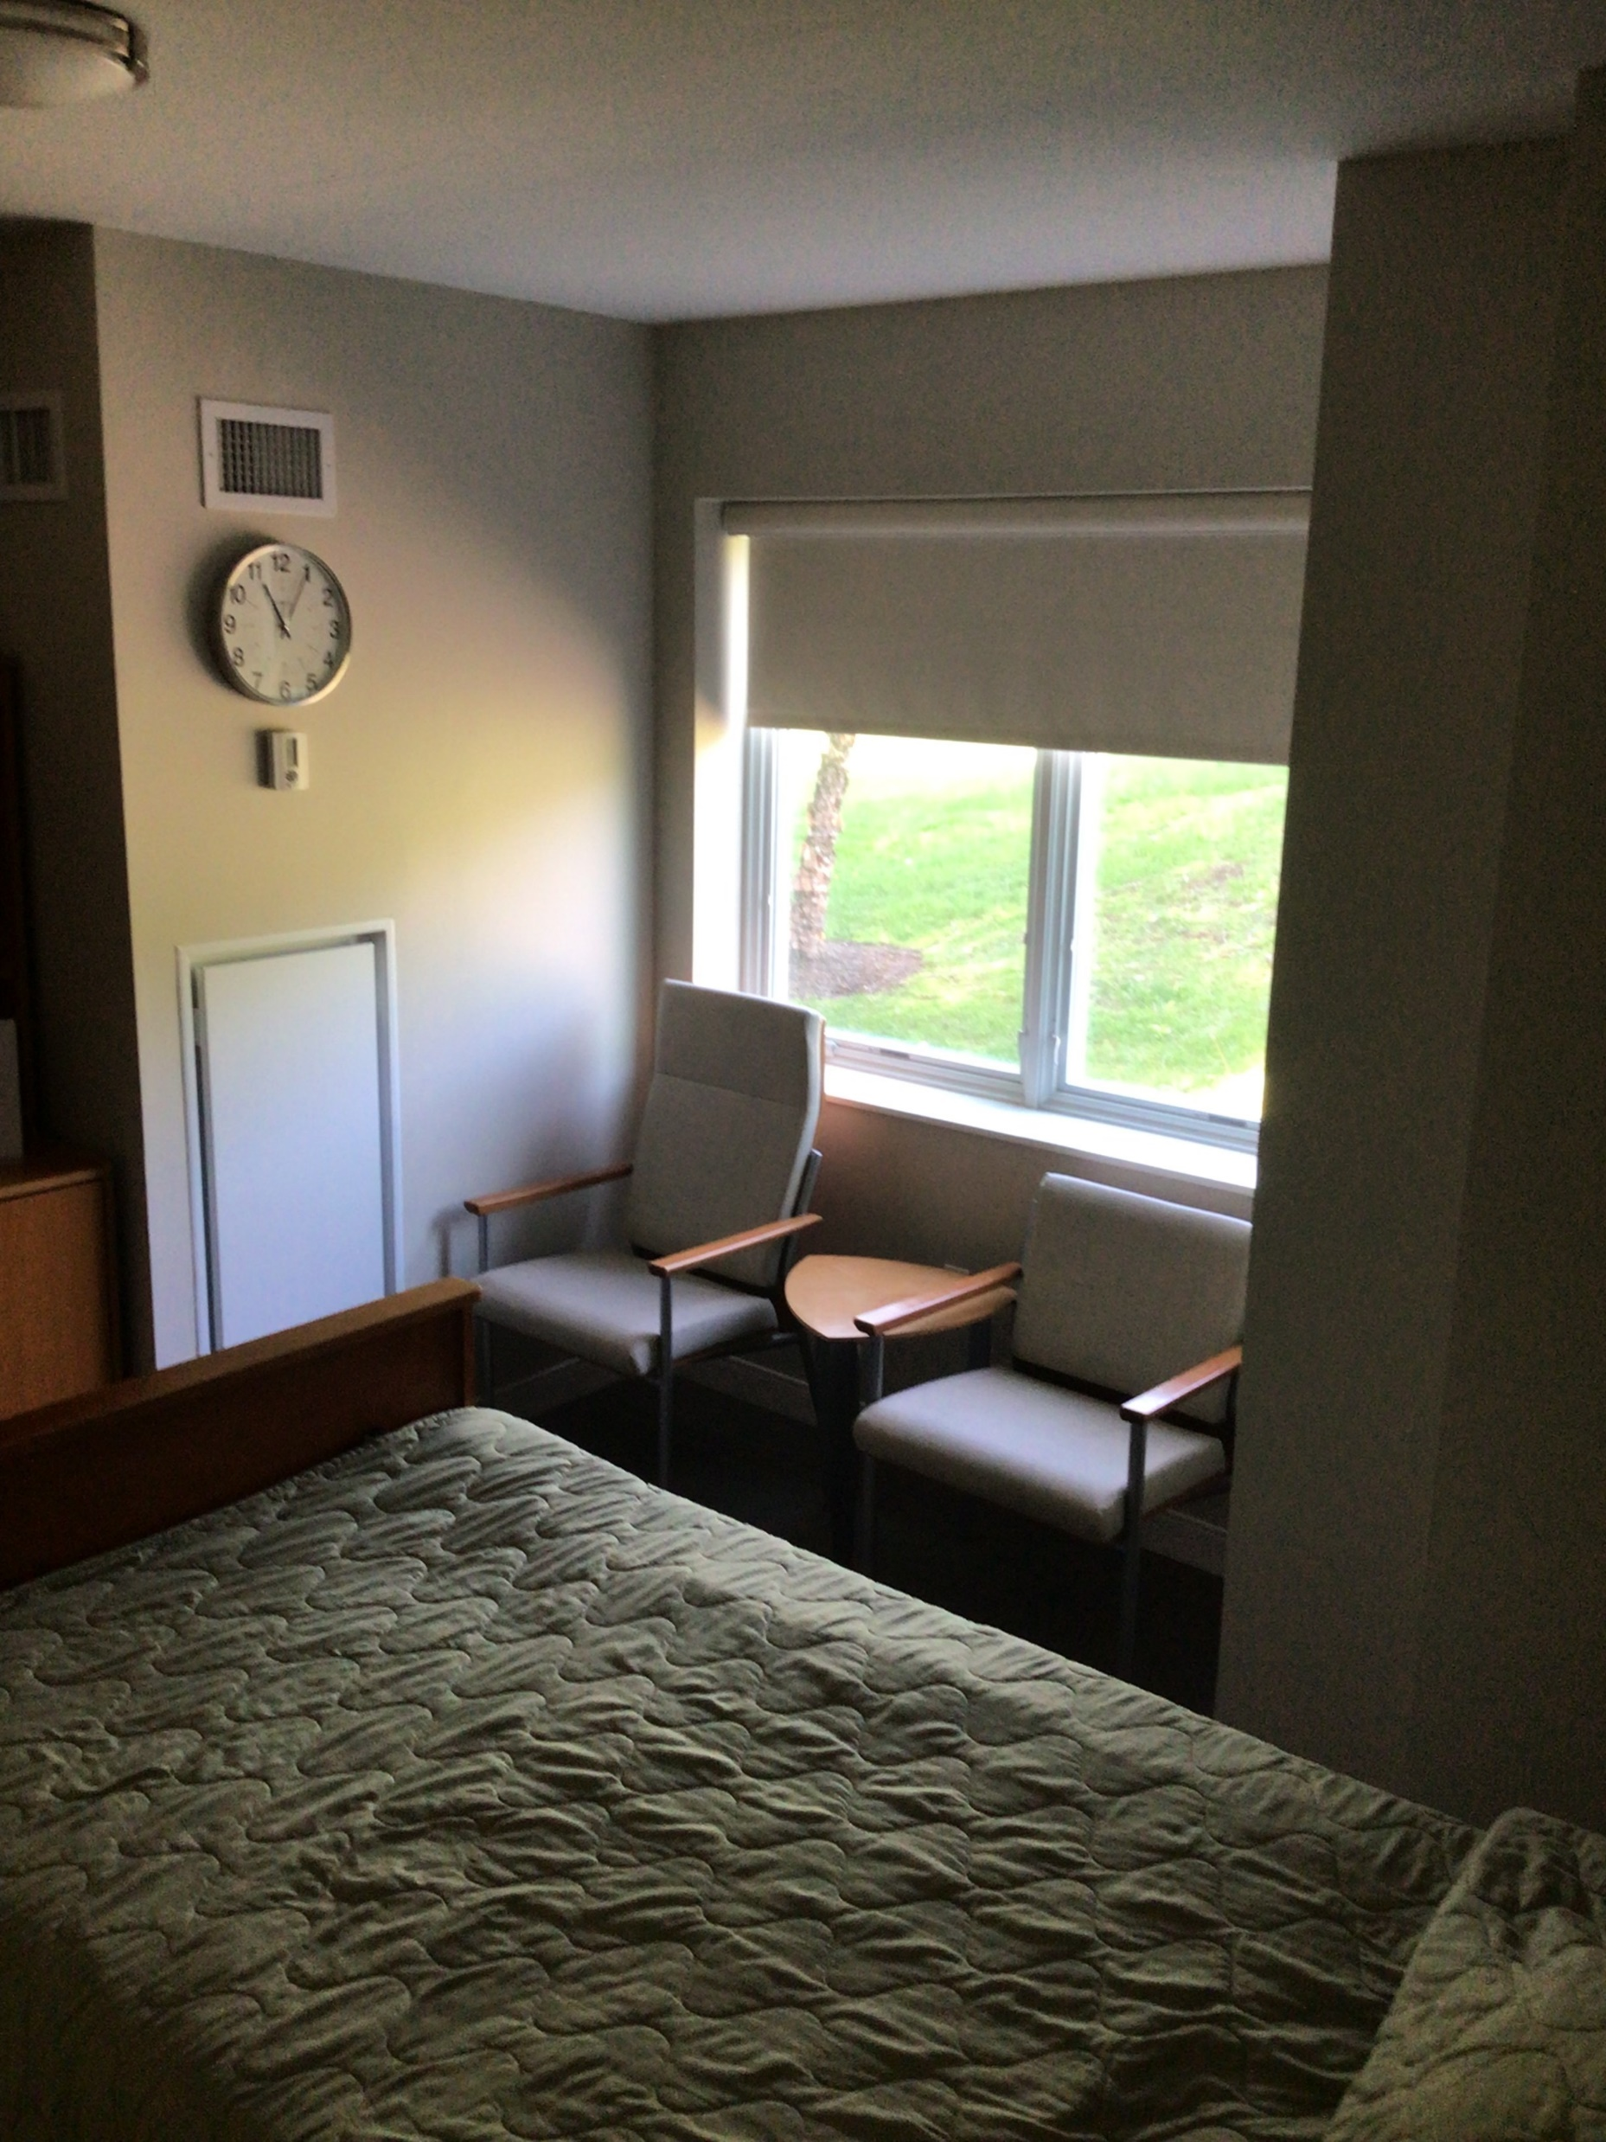
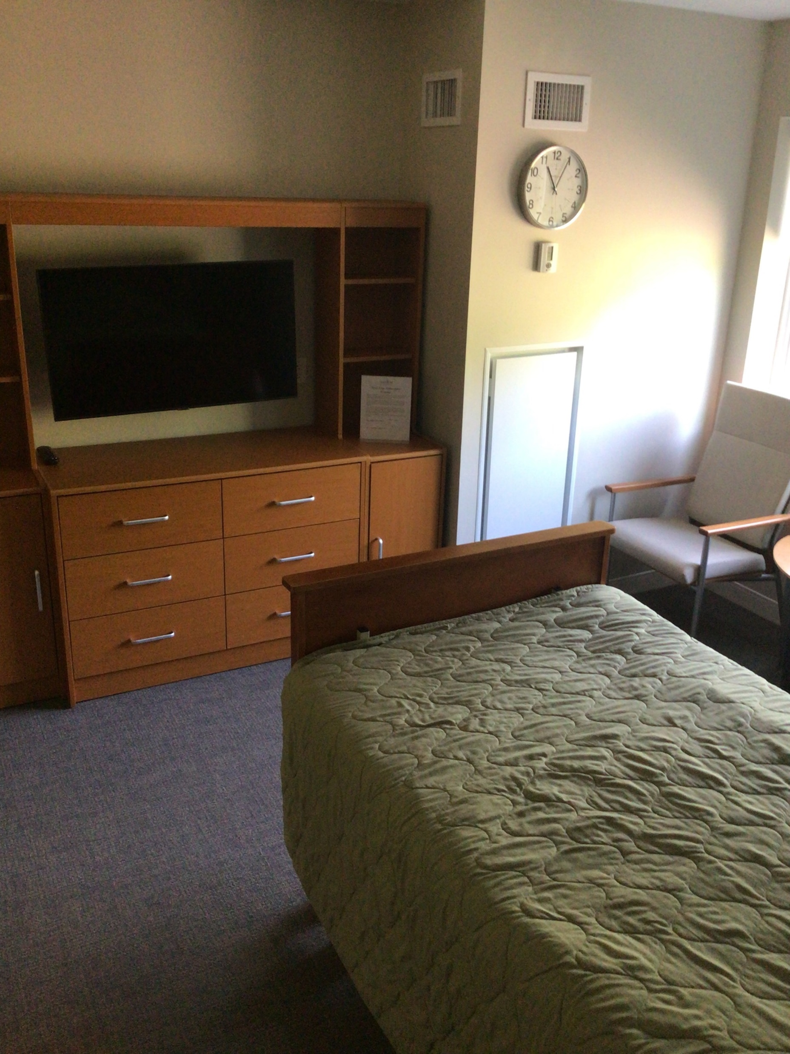
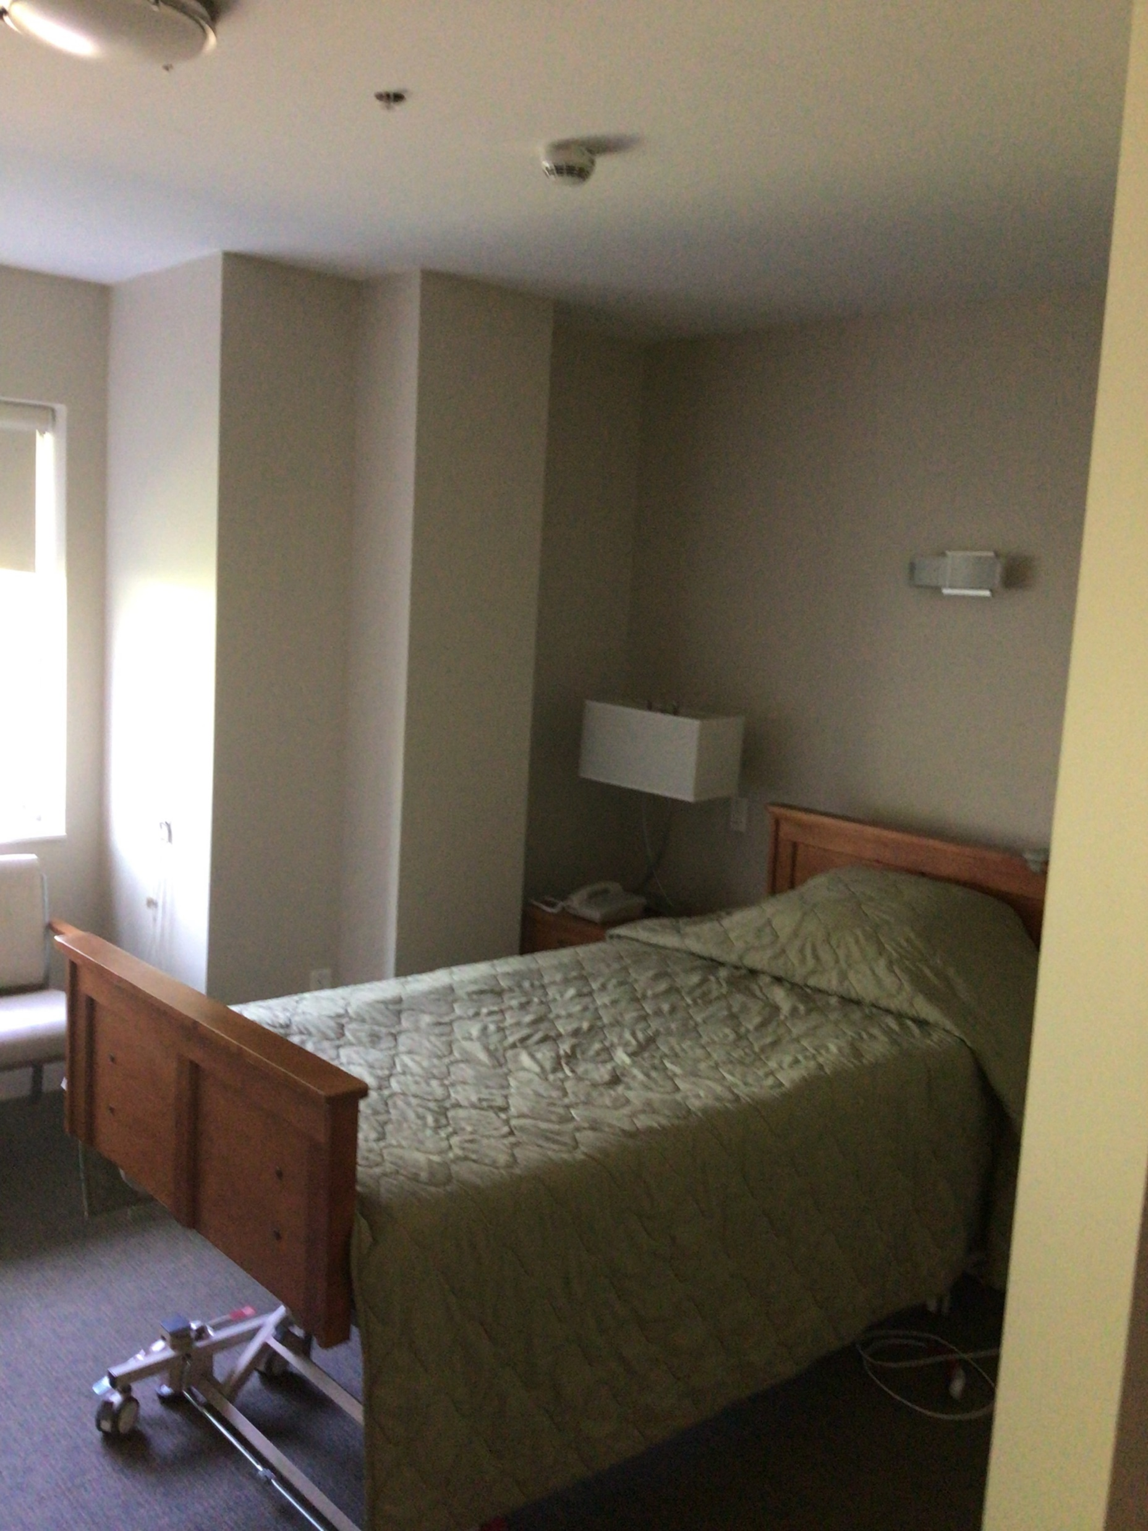

Slide 22
Heights Club Member Health and Wellness
Massage Raffle
Home Safety Evaluation Raffle
Invitations to Educational Offerings at North Hill
Attend the Weekly Blood Pressure Clinic every Tuesday @2pm , 5th Floor K Lounge
Referrals are prioritized from Heights Club Members

Slide 23
Thank you for attending!
Any questions please contact:
Kathleen Sousa for Home Health or Outpatient Rehabilitation
781-433-6317
Debra Doherty for Home Health
781-433-6276
Kathleen Burns for Home Support
781-433-6333
Janet Robinson for Pines Edge
781-433-6229

